Slide 1
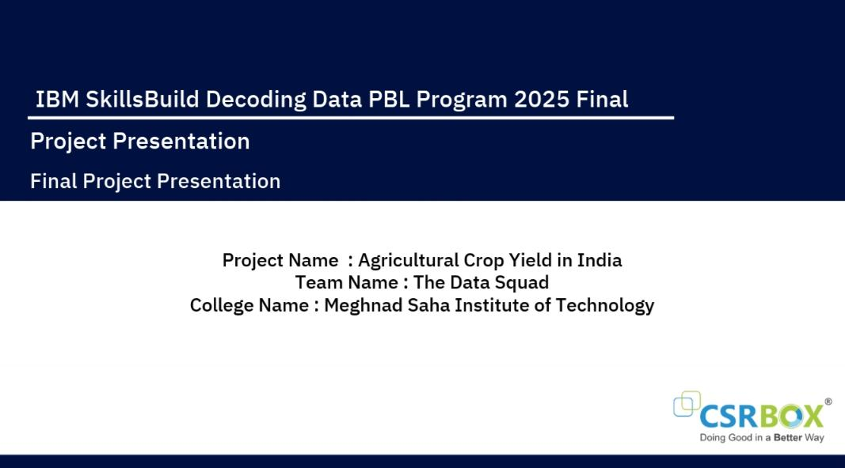

Slide 2

Team members
Ritabrita Karmakar
Kriti Kumari
Barna Das
Atrayee Dutta

Slide 3
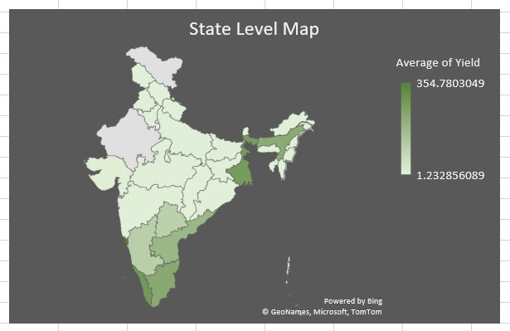
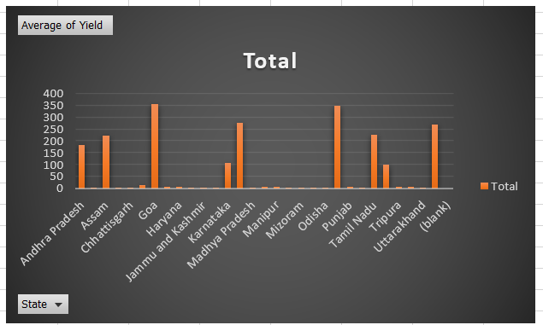
Enhancing Agricultural Crop Yield in India: A Data-Driven Approach
This presentation outlines a strategic initiative to optimize agricultural crop yield in India. We aim to leverage advanced data analytics and machine learning to address critical challenges, predict future trends, and propose actionable strategies for improving crop output and farmer livelihoods across the nation.

Slide 4




Project Overview
Addressing Challenges in India's Agricultural Sector
The Problem
Our Objective
India's agricultural sector faces significant challenges, including climate change impacts, inefficient resource management, soil degradation, and pest outbreaks. These issues lead to food insecurity, economic instability for farmers, and hinder overall national development.
Our goal is to create a data-driven system that provides timely, actionable insights to farmers, enabling them to make informed decisions. This will enhance productivity, ensure food security, and boost economic stability for millions.
SDG 2: Zero Hunger
SDG 8: Decent Work
Promote sustainable agriculture to end hunger and achieve food security.
Foster economic growth and productive employment for all, especially farmers.
SDG 12: Responsible Consumption
SDG 13: Climate Action
Ensure sustainable production patterns by optimizing resource utilization.
Implement urgent measures to combat climate change and its impacts on agriculture.

Slide 5
Comprehensive Data Collection for Agricultural Insights
Our data-driven approach relies on a diverse range of sources to gather the most comprehensive information on agricultural crop yield in India. This multi-faceted data collection strategy ensures accuracy and depth for our analysis.
Key Data Sources
Data Categories
Collection Methods
Government agricultural departments (Ministry of Agriculture)
Crop-specific historical yield data
API integration for government and weather data
Climatic data: rainfall, temperature, humidity
Meteorological departments (IMD)
Web scraping from public agricultural databases
Remote sensing via satellite imagery
Soil data: type, pH, nutrient content
Agricultural research institutes
Irrigation methods and water sources
Partnerships with research institutions
Farmer surveys and field data
Fertilizer and pesticide usage records
Direct farmer surveys and interviews for qualitative insights
Market prices and economic indicators

Slide 6
Robust Data Preprocessing for Accurate Analysis
Ensuring the integrity and usability of our data is paramount. Our rigorous preprocessing steps transform raw data into a clean, consistent format, ready for in-depth analysis and model training.
Cleaning
Handle duplicates and inconsistencies
1
Correct data entry errors
Standardize units of measurement
Identify and remove outliers
Missing Values
Impute using statistical methods (mean, median)
2
Forward/backward fill for time-series data
Regression imputation for complex patterns
Delete rows/columns if necessary
Transformation
Normalize/standardize numerical features
3
One-hot encode categorical variables
Feature engineering (e.g., growing degree days)
Time-series decomposition

Slide 7
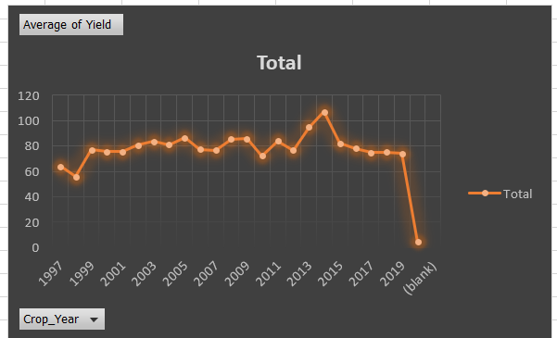
Advanced Analytics for Deeper Agricultural Insights
🔧 Analytical Tools and Methods Used
Excel (Pivot Tables & Slicers):
Aggregated average yield by Crop, Year, and State
Interactive filters for multidimensional analysis
Power BI:
State-wise map visualization using geospatial data
Line/Bar charts for year-wise trend analysis
Slicers for interactive filtering (Crop, State, Year)
Descriptive Statistics:
Mean yield comparisons across crops and states
Seasonal and annual variations observed
📌 Key Findings
• High yields: Coconut, Sugarcane; Low: Cotton, Castor Seed
• Top states: Tamil Nadu, Kerala, Punjab
• Year-to-year fluctuations observed
• Seasonal differences in yield
💡 Insights Derived
• Policy focus on underperforming regions
• Export potential in high-yield crops
• Season-wise planning guidance
• Suggests further analysis on input-yield correlation

Slide 8
Testing the Hypothesis: A Pilot Program Approach
To validate our hypothesis, we will implement a structured pilot program, comparing traditional farming practices with those guided by our data-driven advisory system.
Method for Testing
Rationale Behind Hypothesis
Pilot Program: Select specific agricultural regions in India.
Current practices lack precise, localized information, leading to suboptimal resource use.
Control vs. Treatment Groups: Divide farmers into control (traditional) and treatment (advisory system) groups.
Timely, data-backed advice empowers farmers to make informed decisions.
Data Collection: Continuously gather data on yield, input costs, and farmer satisfaction across multiple seasons.
Integrating diverse data sources allows for more accurate and personalized recommendations.
Statistical Comparison: Use t-tests and ANOVA to compare yield and profitability.
Improved resource efficiency (water, fertilizer) directly translates to higher yield and lower costs.
Qualitative Feedback: Collect farmer insights on system usability and effectiveness.

Slide 9




Solution Design: AI-Powered Yield Optimization Platform
Our proposed solution is the "Agricultural Crop Yield Optimization Platform" (AYOP), an AI-powered system designed to revolutionize farming practices in India.
Data Integration Module
Predictive Analytics Engine
Collects real-time weather, soil, satellite, and historical yield data for a unified view.
Uses ML models to forecast yield and identify risks like drought or pest outbreaks.
Recommendation Engine
Dashboard & Visualization
Delivers personalized advice on sowing, irrigation, fertilizer, and pest alerts via mobile app.
Intuitive interface for farmers and extension workers to visualize data and recommendations.

Slide 10
Platform Features and Site Map
The AYOP is designed with user-centric features and a clear navigation structure to ensure ease of use and maximum impact for farmers.
Prominent Features
Site Map
Interactive Dashboard: Predicted yield, weather, soil health.
Home/Dashboard: Farm overview, current recommendations.
Geospatial Maps: Visualize yield variations, soil types.
My Fields: Detailed view of individual fields, soil data.
Crop Health Monitoring: Satellite imagery for vigor assessment.
Recommendations: List of current and historical advisories.
Alerts: Real-time notifications for weather, pests.
Weather Forecast: Detailed predictions for farm location.
Recommendation Cards: Actionable advice on irrigation, fertilizer.
Pest & Disease Alerts: Information and mitigation strategies.
Historical Tracking: View past yield and compare with recommendations.
Market Prices: Current rates for various crops.
Reports: Generate reports on yield, input usage, profitability.
Settings/Profile: User preferences, farm details.

Slide 11
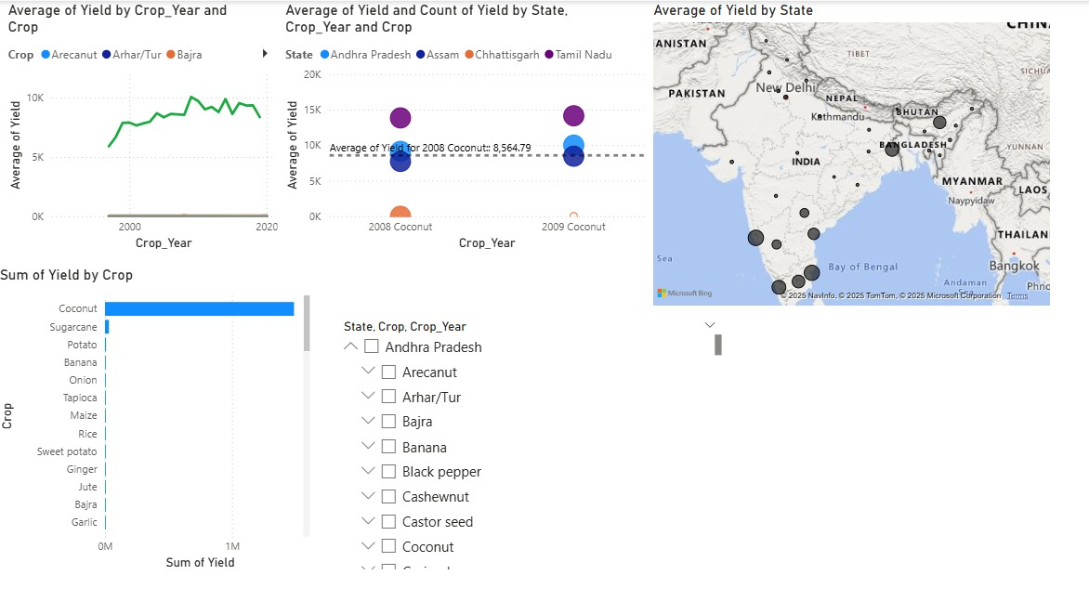
Conclusion: Driving Impact and Future Growth
The Agricultural Crop Yield Optimization Platform (AYOP) is poised to create a significant positive impact on India's agricultural landscape. By empowering farmers with data-driven insights, we aim to achieve sustainable growth and resilience.
Impact of Proposed Solution
Increased Crop Yield & Farmer Income
Enhanced Food Security
Sustainable Farming Practices
Improved Climate Resilience
Future Work
Integration of IoT sensors for real-time monitoring.
Development of a community forum for knowledge sharing.
Expansion to cover livestock and aquaculture management.
Blockchain for supply chain traceability and fair pricing.
Advanced ML for hyper-localized predictions.

Slide 12
Consolidated References for Agricultural Crop Yield in India Presentation
For a comprehensive presentation on agricultural crop yield in India, you would typically draw upon the following types of sources:
Government Publications & Data:
Ministry of Agriculture & Farmers Welfare (MoA&FW) reports and statistics (e.g., Directorate of Economics & Statistics).
India Meteorological Department (IMD) for climate and weather data.
National Sample Survey Office (NSSO) reports on agricultural households and practices.
NITI Aayog documents and policy briefs related to agriculture.
Economic Survey of India.
Academic Research & Journals:
Peer-reviewed articles from journals focusing on agricultural economics, agronomy, environmental science, and data science applied to agriculture (e.g., Indian Journal of Agricultural Economics, Journal of Agricultural Science, Remote Sensing, Computers and Electronics in Agriculture).
Research papers from agricultural universities and institutes (e.g., ICAR institutes).
International Organizations' Reports:
Food and Agriculture Organization of the United Nations (FAO).
World Bank, International Monetary Fund (IMF) reports on India's economy and agriculture.
International Food Policy Research Institute (IFPRI).
United Nations Sustainable Development Goals (SDG) report.

